Slide 1
Star Formation
Morgan Langford

Slide 2
What we’re going to cover:
Interstellar Medium
Interstellar Clouds and Dust
Stellar Nurseries
The Protostar
My Research

Slide 3
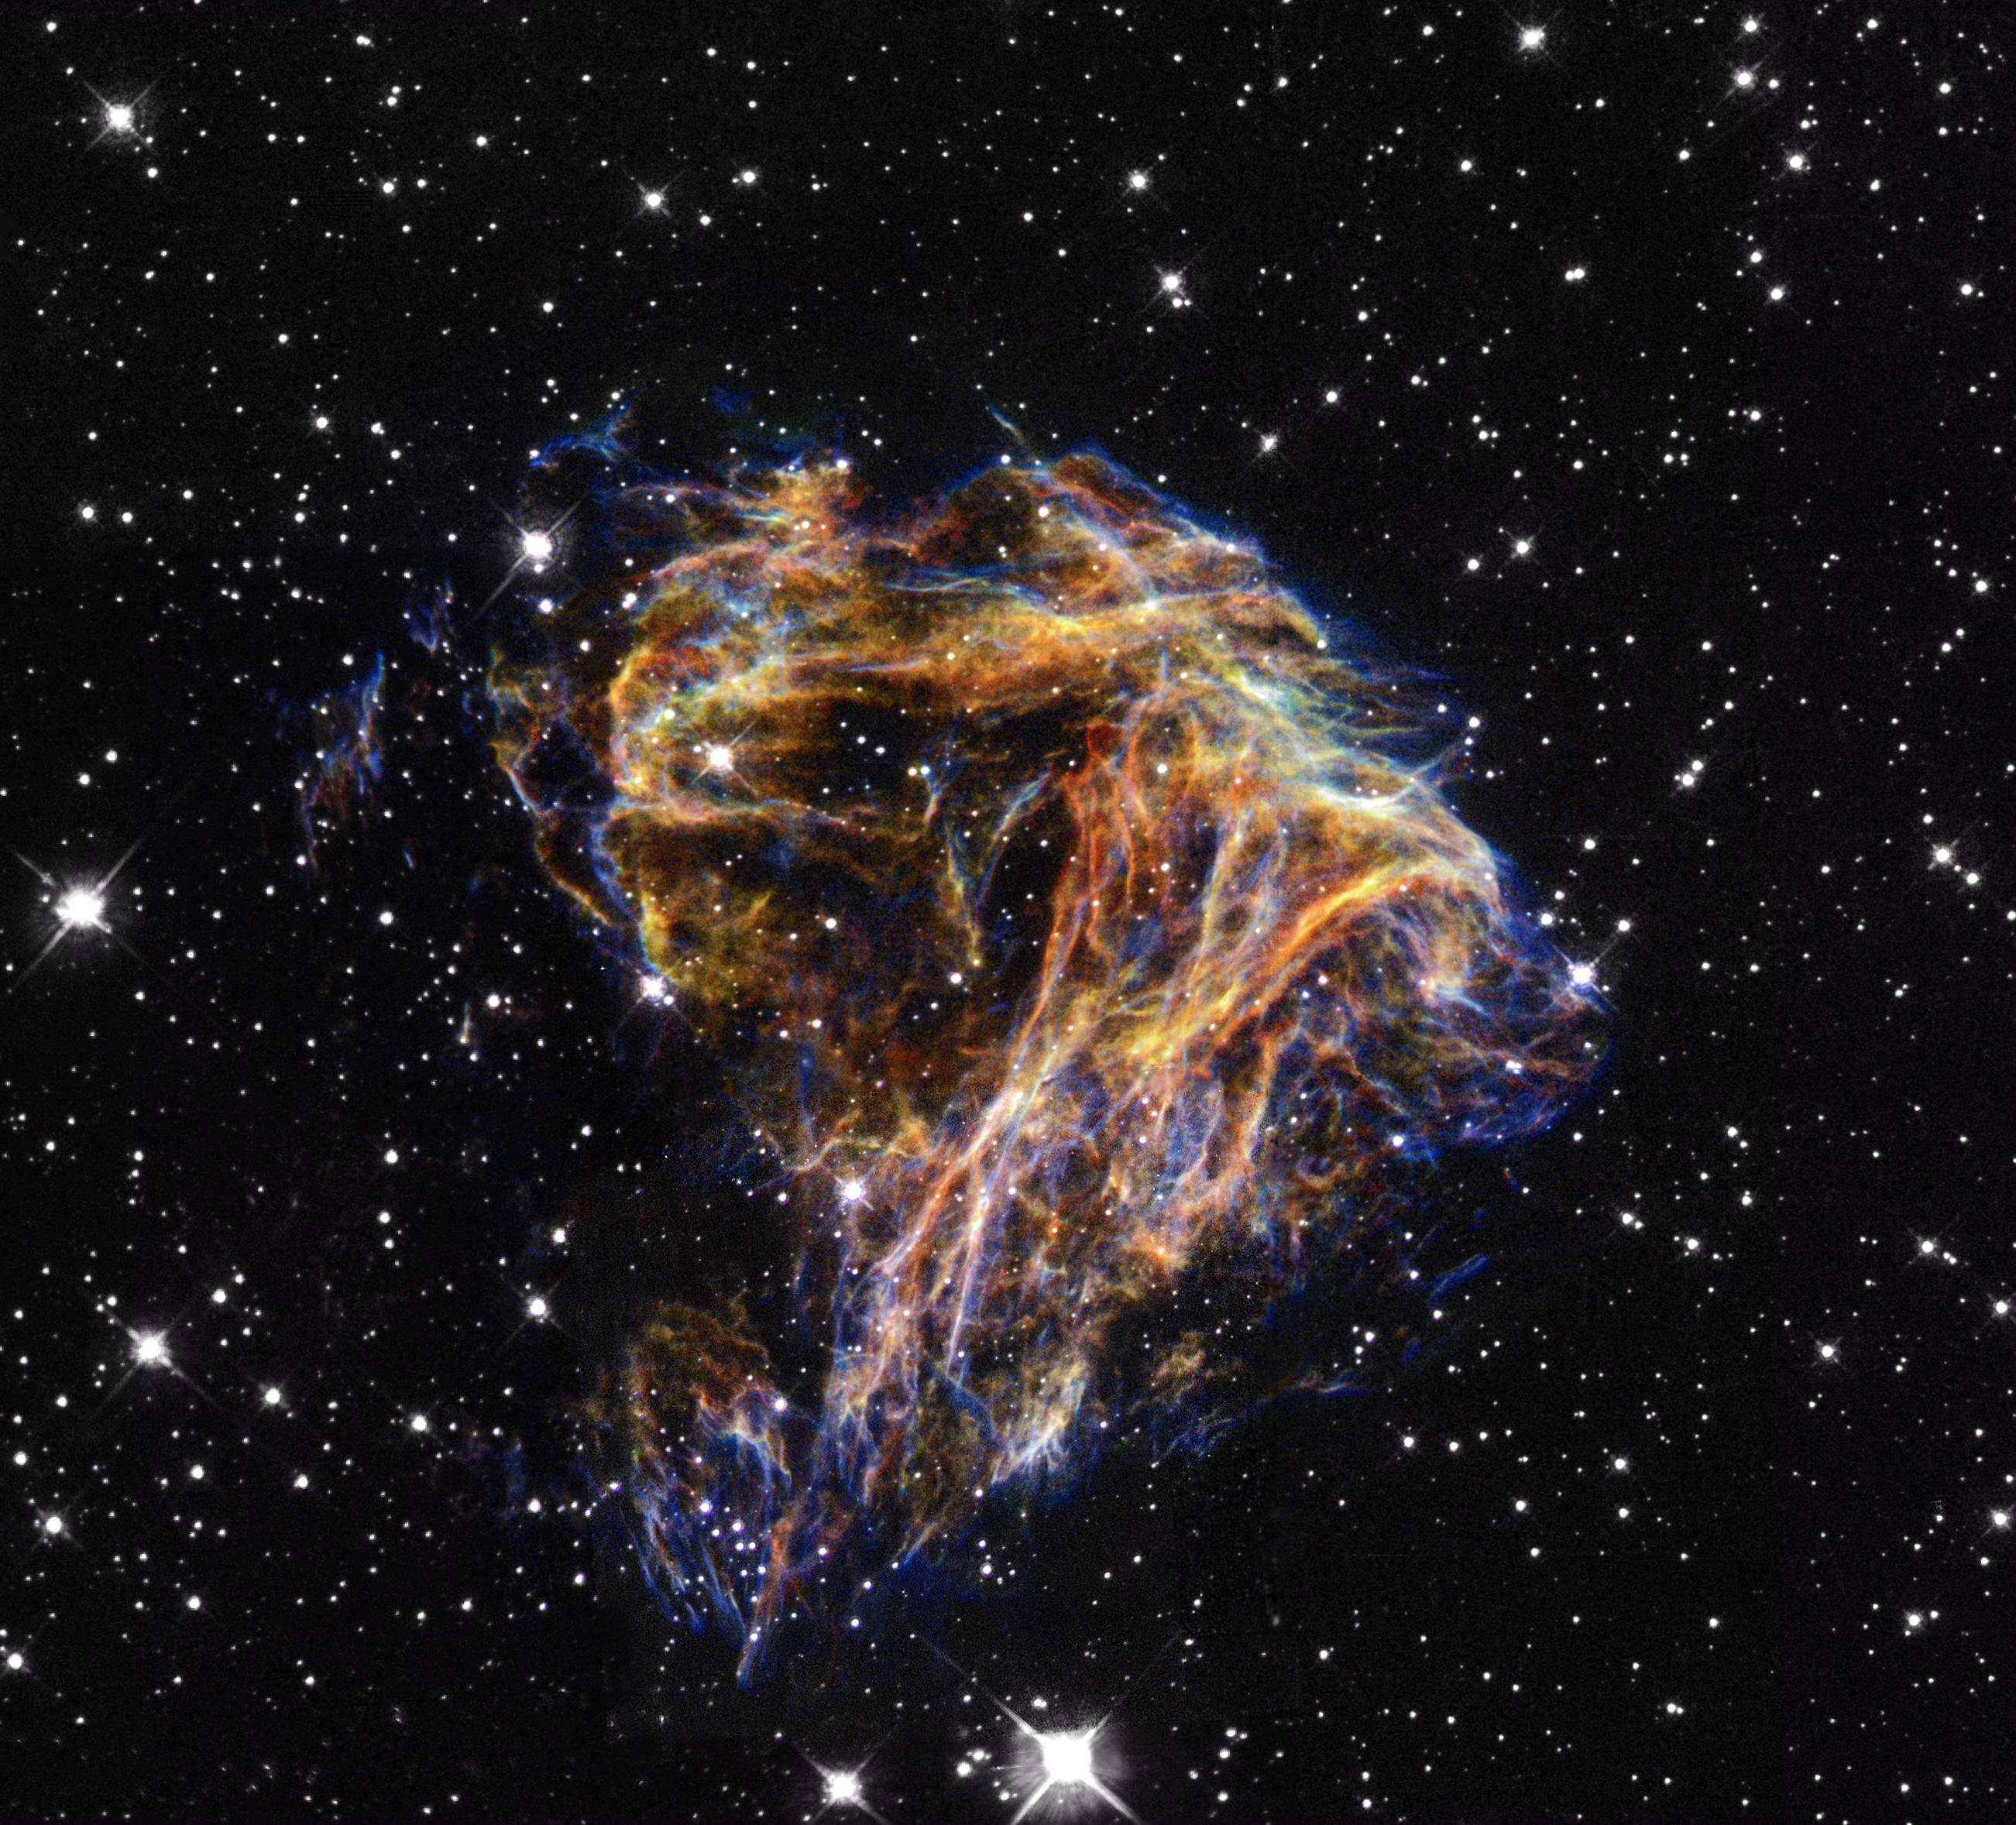
Interstellar Medium: The Space Between the Stars
Matter (gas, dust)
EM radiation
Gravitational field
Magnetic Field
http://abyss.uoregon.edu/~js/ast122/lectures/lec24.html
Notes:
Remove cosmic rays
Look up size of dust. What is dust? On Earth and in space?
Remind them that the distance between the stars is not totally void;
Look up interstellar medium phases

Slide 4
Interstellar Medium
Chemical composition:
~90% Hydrogen
~10% Helium
~0.1% more massive elements
~99% of interstellar matter is gaseous
Avg Density: 0.1 atoms/cm^3
Notes:
Is that the average density?

Slide 5
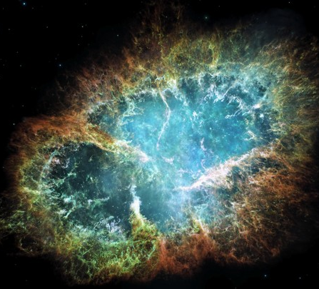
Intercloud Gas
Gas between interstellar clouds
Hot ionized medium:
Ranges from thousands to millions of degrees kelvin
Hottest is heated mostly by supernovae
Makes up 98% of the volume of interstellar space but only about ~1% of the mass
https://www.theatlantic.com/science/archive/2016/01/rare-
supernova-crab-nebula/424125/
Notes:
Might not need this slide. Not super relevant
Check 1%. We’re not sure

Slide 6
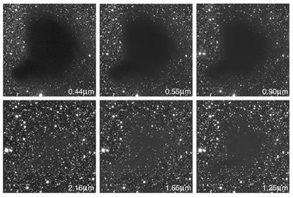
Interstellar Dust
~1% of the material in the ISM is dust
Between the size of a large molecule to ~300nm across
Extremely good at blocking out light
‘Interstellar extinction’
Better at blocking out shorter wavelength light
http://astronomy.swin.edu.au/cosmos/E/Extinction

Slide 7
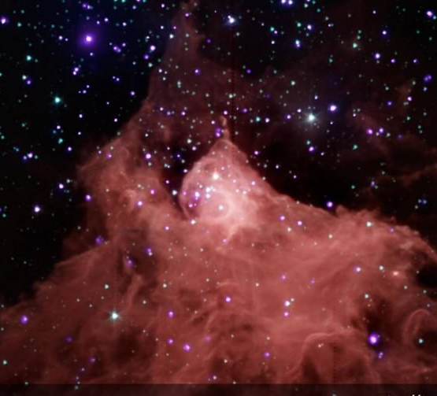
Interstellar Clouds
Average T = ~100 kelvin
Composed mostly of neutral atomic H
Relatively dense
Only in the densest clouds can molecules exist
‘Molecular clouds’
~10 kelvin, cold and dense
Between ½ ly across to over 1000 ly in size
https://astrobiology.nasa.gov/news/first-mapping-of-interstellar-clouds-in-three-dimensions/

Slide 8
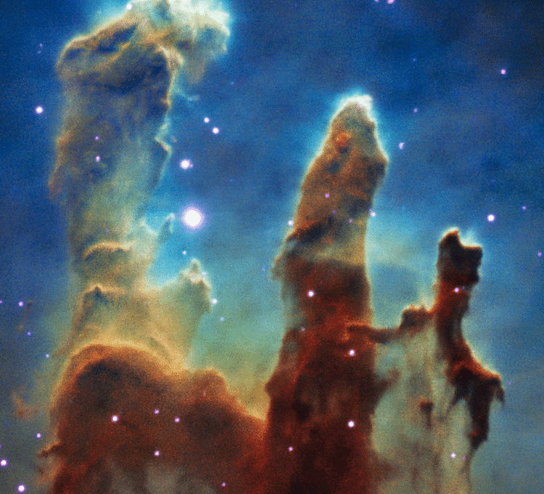
Stellar Nurseries
Molecular clouds are the “cradles” of star formation
Interstellar clouds have self-gravity
Some are massive, dense and cool
Self-gravity >> internal pressure
Cloud collapses under its own weight
https://www.researchgate.net/figure/Pillars-of-Creation-Interstellar-cl
oud-of-gas-and-dust-in-the-Eagle-Nebula-known-for_fig1_321160872
Notes:
Look up Jeans mass/Jean’s length

Slide 9
How the Cloud Collapses
Molecular clouds are never uniform
The denser areas collapse faster
Self-gravity increases at an accelerated rate
‘Molecular cores’
The core collapses under its own weight
Because of the cloud’s angular momentum, it forms a flat, rotating disk
‘Accretion disk’
Protostar at the centre

Slide 10
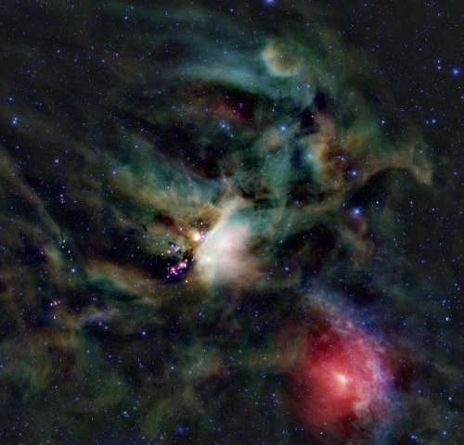
The Protostar
Gravitational energy is converted to thermal energy
Protostar is huge
100x size of Sun
S.A. is tens of thousands of times larger
1000x more luminous
No nuclear reactions yet
https://phys.org/news/2013-04-telescope-probes-young-protostar.html

Slide 11
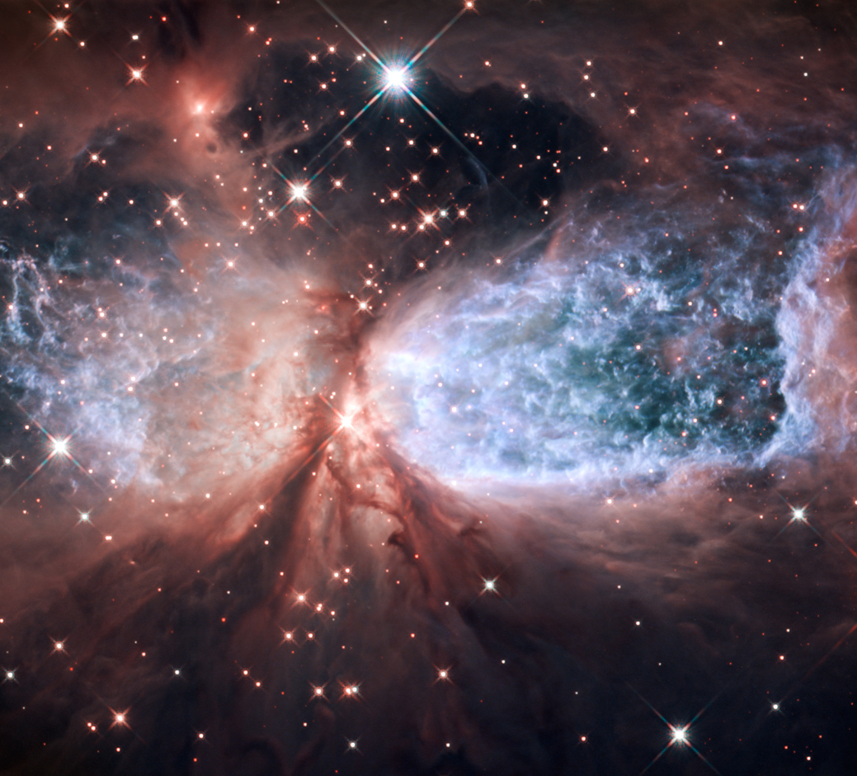
Balanced Forces
Hot-gas pressure outwards = self-gravity pulling inward
Changes constantly because material is continuously falling onto the protostar
Increased gravitational pull increases internal pressure
Increased gravity increases internal temperature
Keeps growing hotter until…
Hydrogen fusion happens!
https://gamingshogun.com/2011/12/15/incredible-
star-birth-image-capture-by-hubble/
Notes:
Not perfectly in balance

Slide 12
My Research
Combining data from multiple telescopes
Find the temperature, mass and luminosity of a star forming region
Using software and programming
I don’t know exactly how yet
Notes:
Looking at data from l = 10, l = 30
Looking directly at galactic center is 0 degrees
Which telescopes? Herschel and JCMT (James Clark Maxwell Telescope)

